Slide 1
Developing a Research Question

Slide 2
How do I design my question?
Your question needs to be specific and focussed.
You can start with a topic but then you need to narrow it down to a particular area as it is easy to become overwhelmed with too much information.
Your topic is a starting point. Your question gives you an angle and a focus.

Slide 3
Performance Standards
P1 Consideration and refinement of a research question.
Grade | Description
A | Thorough consideration and refinement of a research question.
B | Consideration and some refinement of a research question.
C | Some consideration of a research question, but little evidence of refinement.
D | Basic consideration and identification of a broad research question.
E | Attempted consideration and identification of an area for research.
Notes:
You won’t necessarily be at an A grade for this on returning in term 3. The point of refinement is that it is a process. Expect your question to change shape as your research develops.

Slide 4
Common problems
Unclear: Why are social networking sites harmful? Clear: How are online users addressing privacy issues on Facebook?
Unfocused: What is the effect on the environment from global warming? Focused: How is glacial melting affecting penguins in Antarctica?
Too simple: How are doctors addressing diabetes in Australia? Appropriately Complex: What are common traits of those suffering from diabetes in Australia, and how can these commonalities be used to aid the medical community in prevention of the disease?
Notes:
Quite often a simple, unfocussed or unclear question will lead to simple, unclear and unfocussed research then outcome too. It is almost possible to judge the quality of an entire RP on the question alone.

Slide 5


Slide 6
It is expected that you show evidence of how you arrived at your question in order to fulfil performance standard P1
This can be a handwritten brainstorm, concept map, lotus diagram or any other method you find useful
It is evidence of the research process. Formulating your question is the first step
Notes:
On p10 of i-xplore, there are a number of sites/apps etc that you can use to help brainstorm or mind map. This is important evidence and will likely be included in your final folio so it is worth putting in the time and effort to ensure you have thoroughly considered various aspects of your topic,

Slide 7
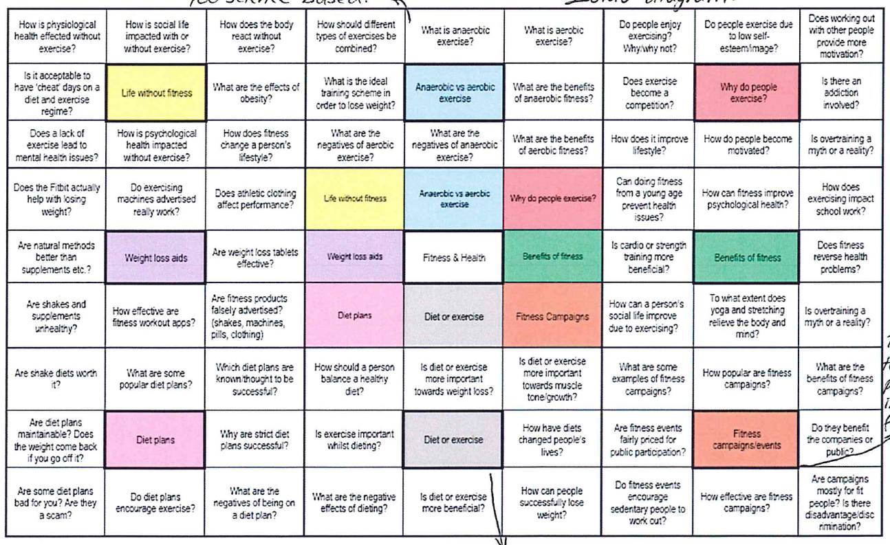
Notes:
This student ended up deciding to focus on what the best way was to combine strength and cardio training, making a website for her outcome (answer) where she was able to include videos she had made and synthesise the research from her sources such as PTs and various websites. https://jpar100687.wixsite.com/workouts958310g/1

Slide 8
Developing and Refining your Research Project Question

Slide 9
Developing a Research Question
The key to a successful Research Project is developing a workable and interesting research question that is neither too large, nor too narrow.

Slide 10
Considerations when designing a Research Project question
Is the proposed research question researchable?
Where will the information be found? Are there opportunities for other types of research processes to be used outside of just collecting secondary information? Will you be able to talk to people about your question? This may be in the form of a survey or experts in the field but your research must go beyond your laptop.
Notes:
I would say that the biggest key to a successful RP is to choose a question that allows you to investigate it through a wide range of processes – experiments, surveys, interviews, blogs, books, articles, action research etc etc – p16ff has many suggestions categorised under the 4 main research types

Slide 11
Considerations when designing a Research Project question
2. Is the proposed research question manageable in the time frame?
Is the topic too broad? Can it be refined?
3. Is the proposed question safe and appropriate?
What are the ethical considerations? Is it in keeping with the school’s FISHER principles?
Notes:
3. Is particularly important if you are thinking of doing any kind of experiments. People should always leave you the same or better condition after taking part n your study. If you do psych you’ll already be aware of this.

Slide 12
Considerations when designing a Research Project question
4. Is the proposed research question open-ended, in order to provide scope for extensive research?
A closed question such as “Is obesity going to cost Australia?” invites a yes/no answer and therefore limits the research. An open ended question such as “What are the social costs of the increase of obesity to Australia?” allows you to investigate financial, employment, educational, medical costs and so on.
“Why?” questions are generally good for being able to investigate a range of views / opinions / perspectives.

Slide 13
Considerations when designing a Research Project question
5. Do you care? Will anyone else?
Asking a question that doesn’t interest you will lead to a very long semester! Remember that your question will need to sustain your interest for a long period. Similarly, asking questions whose answers may benefit others is a good strategy (it will also help you with your evaluation / review).
Notes:
With this in mind, I thought what I would do if I were completing RP this semester and came up with 5 questions that have personal relevance to me. Some of these I would be informally researching anyway.

Slide 14
What are the most effective strategies to encourage boys of 13-15 to read for pleasure?
What are the benefits of the new Thermomix TM6 model over the older versions?
To what extent can ipads be used effectively in teaching literacy to Year R-2 students?
How can I create an effectively decorated and unusually flavoured cake to celebrate a 40th birthday?
What are the most effective strategies for reducing landfill waste in an R-12 school in Adelaide's NE suburbs?
Notes:
Speak to children. Librarians. Analysis of books. Research papers.
Blogs, TMX consultants, social media, action research, recipe books and online recipes
Experiments (control and ipad group), apps like reading eggs, teachers
Cake decorating course, youtube videos, recipe books and online, forums and groups (e.g. cake hacks on FB)
War on waste TV, observation (look at litter and take photos), speak to council

Slide 15
Considerations when designing a Research Project question
Some useful question stems might include:
How useful.....?
How valuable....?
How accurate...?
How important...?
How reliable...?
To what extent...?
Why....?

Slide 16
Refining your question
The wording of your Research Project question is very important as it shapes the direction you take your research and what your final Outcome is.

Slide 17
Refining your question
How can .....be used to..............................?
Is there a better way to..............................?
Which........is best suited for the purpose of...........?
How can........be better managed?
Should........................be banned?
To what extent is............................significant in Australian life?
Which..................is the most effective in.....?
How can I design and/or make a model of a ...............to illustrate.........?

Slide 18
Refining your question
9. To what extent does the film/book.....accurately portray.........?
10. To what extent did........change between......?
11. How can I produce...........in the style of ..................................?
12. How does the price of............vary between.....over a period of.....? What are the factors influencing these prices?
13. Can......be justified?

Slide 19
Refining your question
You will need to write your question in a variety of different ways to perfect your question.
Example:
Can cosmetic testing on animals be justified?
OR
2. How can cosmetic testing on animals be better managed?
OR
3. To what extent has cosmetic testing on animals changed over the past decade?
OR
4. What are the social implications of cosmetic testing on animals?
OR
5. Is there a better way to conduct cosmetic testing on animals in Australia in 2019?
As you can see, despite the chosen question focus being about cosmetic testing on animals, it is clear that the wording of my question will greatly change the focus of my Research Project.
Notes:
If you can play around with your question and document this, it acts as further evidence of refinement

Slide 20
Refining your question
The question below would be considered “poor” as it does not allow for extensive research, and is “closed”:
“Who was Ned Kelly?”
Using the question stems, can you think of a question that would be considered more successful?

Slide 21
Examples
Does Ned Kelly deserve his reputation as a ruthless bank robber?
To what extent does the 2003 film “Ned Kelly” accurately portray the life of Ned Kelly?
What impact did Ned Kelly have on Australian society during his life?
To what extent did Ned Kelly change the way Australians view criminals in the modern era?

Slide 22
Refining your question
The question below would be considered “poor”
“Is it safe for children to play sport in the year 2019?”
Using the question stems, can you think of a question that would be considered more successful?

Slide 23
Examples
How do sports injuries impact children’s health and wellbeing?
Who is responsible for protecting children’s safety and wellbeing in sport? And what preventative measures are being implemented?
To what extent are schools to be held responsible for sports related injuries that occur at school?
How can childhood sports injuries be better managed in South Australian schools?

Slide 24
The well trodden path
Body image
Concussion
The effects of video games
Photoshop
Medical marijuana
Drugs in sport
AFL and knee injuries
Notes:
This isn’t to say you can’t do these topics and do them well. It’s also not to say that there are not original questions that can be posed around these subjects or new ways of presenting outcomes. It’s just good to know! Sometimes a question may stem from something in the news e.g. The guy who killed people in Melbourne in 2017 led to one of my students looking at changes to bail laws and whether they were exposing the Australian public unnecessarily to danger. Another student’s family was planning a trip to Disney so she made that her RP.

Slide 25
The good . . .
How has the Chinese Remainder Theorem (CRT) advanced the fields of mathematics, particularly the areas of coding and cryptography?
How authentic is Italian cuisine in Modern Australia?
How can I design and produce a formal dress suitable for a Muslim student within a budget of $200?
To what extent does the production of Polytheylene Terephthalate (PET) contribute to annual global CO2 emissions, and what is the best strategy to reduce the effect of this?

Slide 26
The not so good . . .
How does money affect soccer clubs?
What are the effects on an athlete of playing sport?
Which was better – Jurassic Park or Jurassic World?

Slide 27
Have you designed a successful Research Project question?
Criteria for a good Research Project question | Yes/No
1. This question is researchable and allows me to collect information from a range of sources, not just secondary sources
2. The research question is manageable in the time frame
3. The research question is safe and appropriate. Ethical considerations have been taken into account
4. The question is open-ended to provide scope for extensive research
5. The question has been constructed so that it promotes research, not a description
6. The question has a specific focus – parameters such as place and/or time have been defined
7. I am passionate about this question and it will sustain my interest for an entire semester

Slide 28
Your turn
Each group will be given a topic
From this topic, come up with a list of possible research questions

Slide 29
Now I’ve got my question . . .
Once you have arrived at your question, you must then split it in to more manageable parts.
Breaking down your question in to 3 / 4 smaller questions or focus areas will allow you to focus your research and have clearly identifiable key findings in your outcome

Slide 30
To what extent is it more difficult for Jew to keep to the kosher food laws in Adelaide than in Israel?
Kosher – What is it? Where did the rules come from? What are they?
Adelaide – How big is the Jewish population? What fraction of the Jewish population keep kosher? What is available / unavailable in Adelaide for Jews wishing to keep kosher?
Israel - How big is the Jewish population? What fraction of the Jewish population keep kosher? What is available / unavailable in Israel for Jews wishing to keep kosher?
Comparison – in what ways is it more / less difficult for Jews in Adelaide to keep kosher?

Slide 31
How successful is light therapy in the treatment of SAD (Seasonal Affective disorder)?
SAD – What is it? Who gets it? What are the causes?
Light therapy – When and how was it developed? How does it work?
Extent of success – Statistics – how many people have used it? How many have been “cured”? Are there any side effects? Is treatment ongoing?

Slide 32
What specialist doctors are needed for the care of a person Marfan Syndrome?
Marfan Syndrome – What is it? What is the incidence of Marfan Syndrome? How does it affect individuals?
Heart – Cardiologists. Echocardiograms. Medication. Surgeons.
Eyes – Opthalmologists. Glasses / contacts. Surgeons.
Bones – Orthopaedists. Back brace. Surgeons.
Genetics – Geneticists. Fertility doctors.

